Slide 1

INDIAN INSTITUTE OF TECHNOLOGY MADRAS
CHENNAI – 600 036
Sundarayatan Store: A Strategic Analysis for Business Enhancement
Name: Avinash Kumar
Roll Number: 21f1006385
Business Data Management Capstone Project

Slide 2
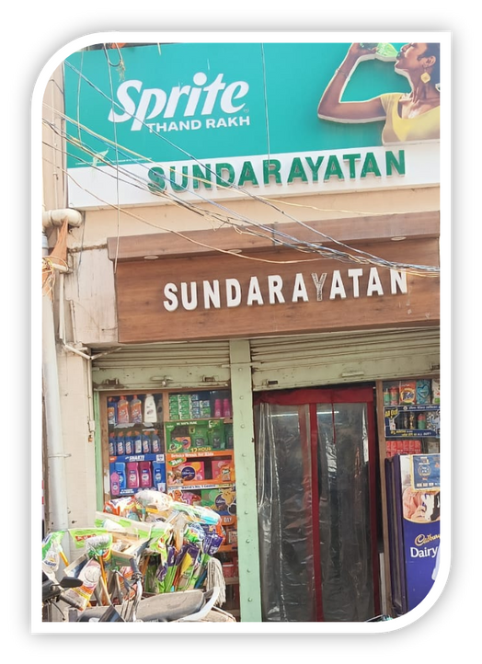
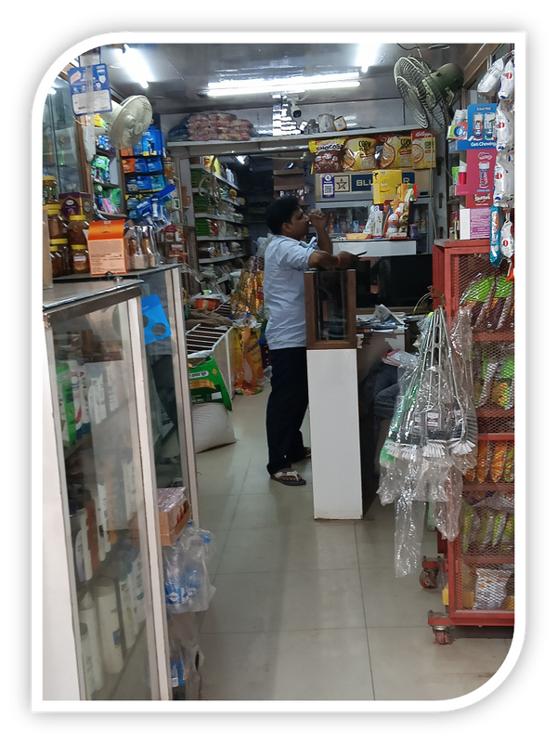





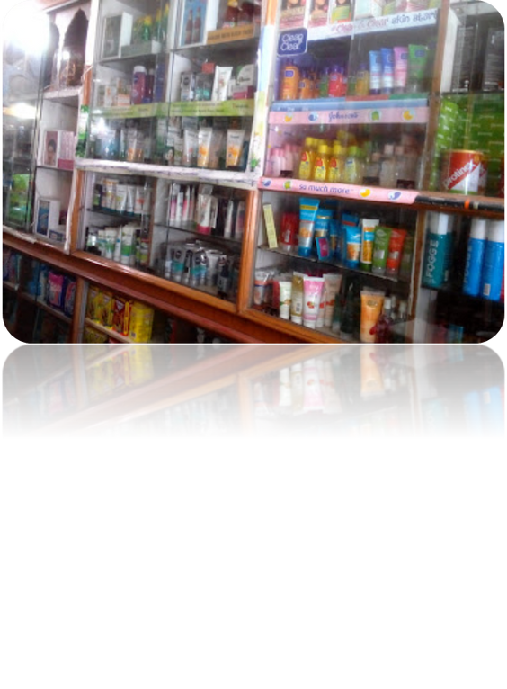
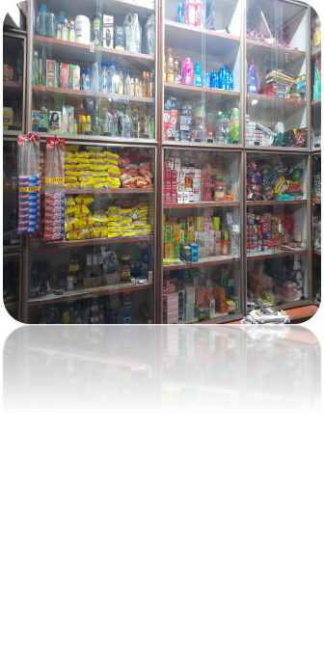

SUNDARAYATAN
STORE
ABOUT ORGANIZATION:
Sundarayatan Stores
Established 2006, Patna (Bihar)
Owner:
Ravi Kumar
Groceries: Rice, Oil, Pulses, Flour, Dairy, etc.
Focus: Affordability & Trust
Location: Patna, Bihar– 800006
Address: Ashok Rajpath Road, near NIT More, Thatheri Bazar, Lalbagh, Patna, Bihar
Business Model: B2C, B2B
Efficiently managed by Mr. Ravi Kumar and supported by 4 staff members for marketing and operations.
Monthly revenue approximately 7.5 Lakhs (INR).
Operational expenses around 6-6.5 Lakhs (INR).
2

Slide 3


PROBLEM STATEMENTS
Inventory Management Issues
Low Net Profit Margins
of Products
Customer Retention & Competitive Strategy
Conduct an in-depth analysis of the store’s inventory with respect to sales trends and procurement patterns to reduce overstocking.
Assess the current profit margins and identify actionable strategies to enhance profitability.
Analyze customer preferences and pricing strategies to improve retention and remain competitive with nearby stores and online platforms.
3

Slide 4
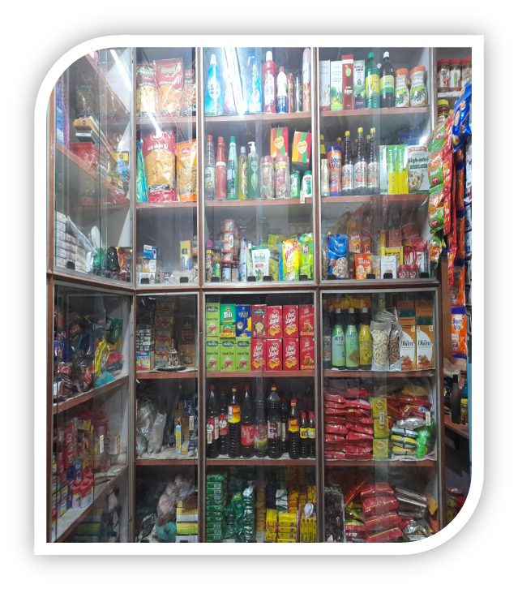
DATA COLLECTION AND METHODOLOGY
1.Data Collection: Primary data collected from March 1st to April 30th, 2025 that is for 61 days.
2.Data Sources:
Internal sales and inventory records.
Supplier invoices and purchase records.
Customer survey data, conducted through survey form.
3.Data Cleaning: Missing values were handled, duplicates removed, and date formats standardized. Currency fields were converted to numeric format for accurate analysis.
4.Methodologies used for Analysis:
Data Visualization Techniques: Mainly used Line chart, Pareto chart, Bar chart, Histogram and Pie chart.
ABC Analysis for Inventory Optimization
Sales Demand Forecasting
Relationship Between Revenue and Profit
Customer Retention & Competitive Strategy
4

Slide 5
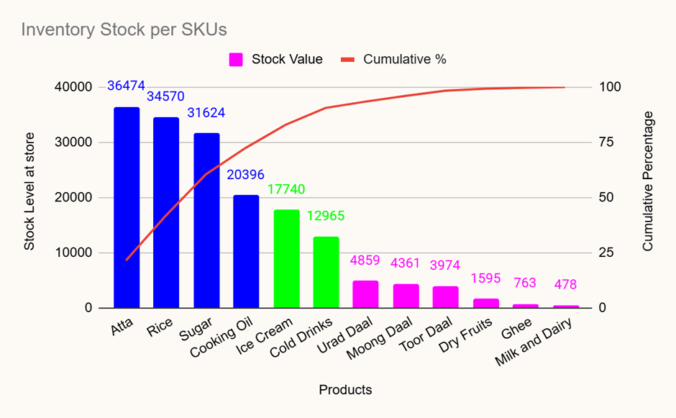
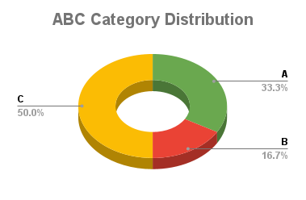
ABC ANALYSIS FOR INVENTORY OPTIMIZATION
Products | Stock Value | Inventory Stock % | Cumulative %
Atta | 36474 | 21.48 | 21.48
Rice | 34570 | 20.36 | 41.84
Sugar | 31624 | 18.62 | 60.46
Cooking Oil | 20396 | 12.01 | 72.48
Ice Cream | 17740 | 10.45 | 82.92
Cold Drinks | 12965 | 7.64 | 90.56
Urad Daal | 4859 | 2.86 | 93.42
Moong Daal | 4361 | 2.57 | 95.99
Toor Daal | 3974 | 2.34 | 98.33
Dry Fruits | 1595 | 0.94 | 99.27
Ghee | 763 | 0.45 | 99.72
Milk and Dairy | 478 | 0.28 | 100.00
A
B
C
Table 1: Stock Level of different Products
A total of SKUs (~4 out of 12) contribute to most of the inventory stock value. Followed by 2 products in category B and 6 products in category C.
Figure 1: Pareto chart and Donut chart
5

Slide 6
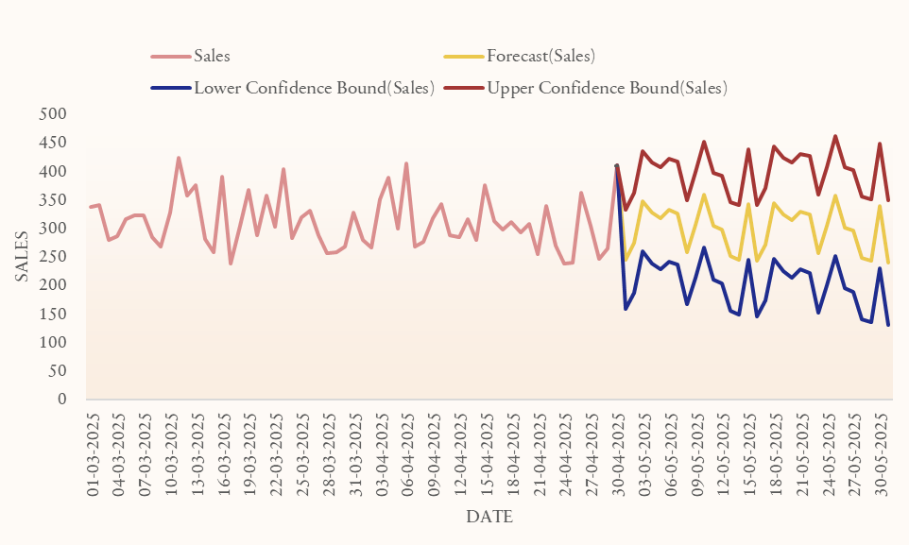
SALES DEMAND FORECASTING
Daily sales fluctuate between 250–450 units (Mar–Apr 2025).
A dip in sales is observed around late March.
May 2025 forecast indicates sales stabilizing between 250–350 units/day.
The lower confidence bound suggests possible dips to nearly 150 units/day.
Forecast carries moderate uncertainty, especially during early May.
Planning tip: Maintain inventory closer to the upper bound (~400–450 units) to avoid shortages.
2021
Figure 2: Forecasted Sales
6

Slide 7
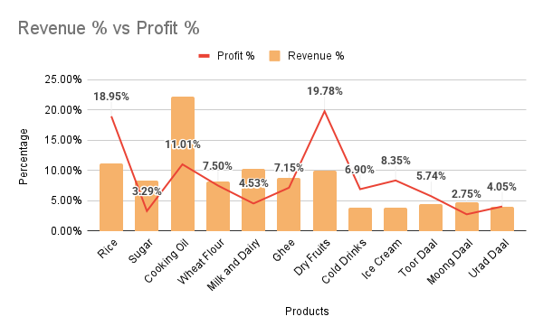
RELATIONSHIP BETWEEN PROFIT AND REVENUE
Products | Profit | Revenue | Profit % | Revenue % | Profit Margin
Rice | ₹32,591.00 | ₹170,040.00 | 18.95% | 11.22% | 19.17%
Sugar | ₹5,654.00 | ₹125,521.00 | 3.29% | 8.29% | 4.50%
Cooking Oil | ₹18,932.00 | ₹336,860.00 | 11.01% | 22.24% | 5.62%
Atta | ₹12,894.50 | ₹124,441.00 | 7.50% | 8.21% | 10.36%
Milk and Dairy | ₹7,794.00 | ₹155,880.00 | 4.53% | 10.29% | 5.00%
Ghee | ₹12,297.50 | ₹134,010.00 | 7.15% | 8.85% | 9.18%
Dry Fruits | ₹34,020.00 | ₹151,200.00 | 19.78% | 9.98% | 22.50%
Cold Drinks | ₹11,870.00 | ₹59,350.00 | 6.90% | 3.92% | 20.00%
Ice Cream | ₹14,350.00 | ₹57,400.00 | 8.35% | 3.79% | 25.00%
Toor Daal | ₹9,870.00 | ₹67,060.00 | 5.74% | 4.43% | 14.72%
Moong Daal | ₹4,726.00 | ₹72,885.00 | 2.75% | 4.81% | 6.48%
Urad Daal | ₹6,960.00 | ₹60,320.00 | 4.05% | 3.98% | 11.54%
SUM | ₹1,71,959.00 | ₹15,14,967.00 |  | Average | 12.84%
Figure 3: Products with Profit and Revenue
Dry Fruits (19.78%) and Rice (18.95%) have high profit contributions relative to their revenue share. Sugar and Cooking oil shows the largest gap, with a high revenue share but very low profit percentage (3.29%).
Table 2: Profit, Revenue and Profit margin of Products
7

Slide 8
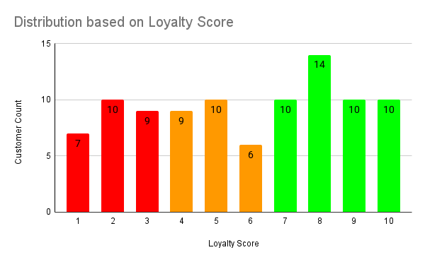
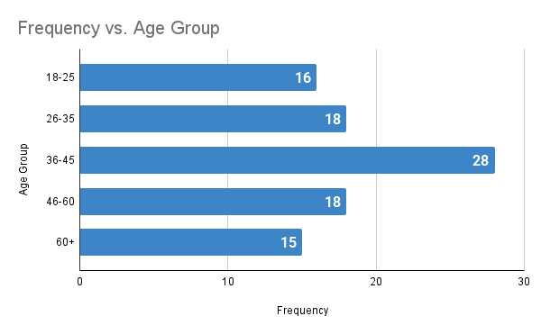
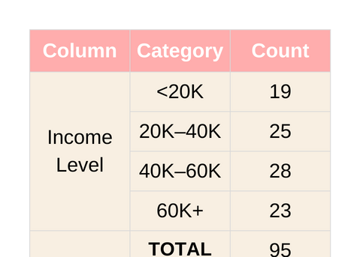
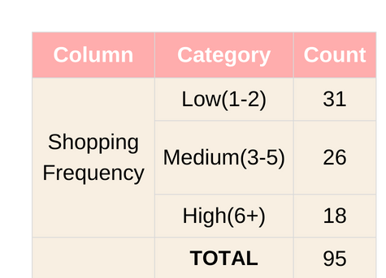
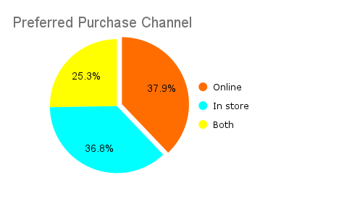
CUSTOMER RETENTION & COMPETITIVE STRATEGY
Figure 5: Distrubution based on Age Group
Table 3: Customer Income Summary
Figure 4: Distrubution based on Loyalty
Loyalty Score = (Shopping Frequency) + (Price Sensitivity) + (Offers Response) + (Competition Visited)
High Risk (1–3) → 27.4%
🔴 These customers are disengaged and at the highest risk of churn.
Need Attention (4–6) → 26.3%
🟠 These customers are on the fence. Proper offers/engagement can move them to loyalty.
Loyal Customers (7–10) → 46.3%
🟢 Largest group — strong retention base, likely to repeat purchase and refer others.
Figure 6: Distrubution on Purchase channel
Table 4: Customer Shopping Frequency
8

Slide 9
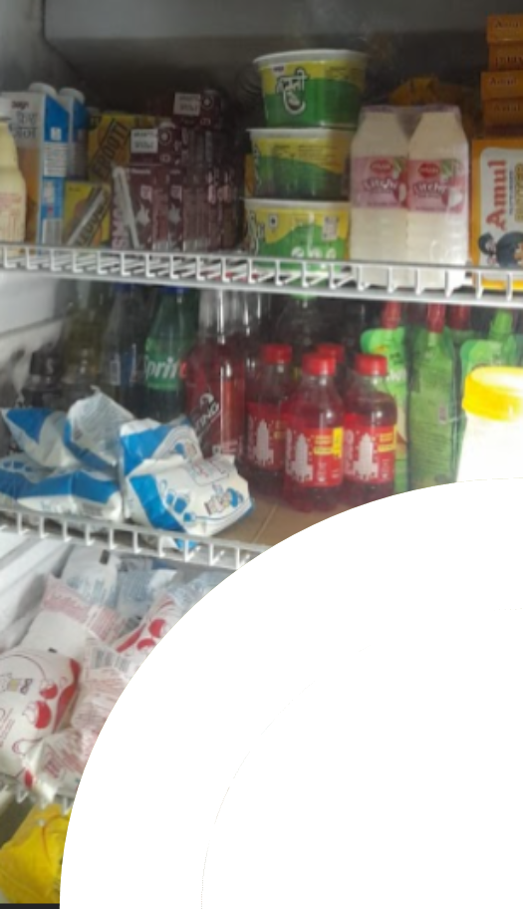

INTERPRETATION AND RECOMMENDATIONS
Key Findings-
Inventory & Sales: A small number of products (Category A items like Atta, Rice, and Sugar) account for most of the revenue (over 75%) but frequently face stockouts. In contrast, Category C items (Dry Fruits, Ghee) have low turnover and are overstocked.
Profitability: There's a wide range in profit margins, with low-margin essentials (Sugar, Moong Dal) and high-margin products (Dry Fruits, Rice, Ice Cream). Some frequently purchased items are priced higher than competitors' products, risking customer loss.
Customer Behavior: The largest group of customers is "at-risk," meaning they've recently made a purchase but haven't become repeat customers. About 38% of all transactions are online, highlighting the need for a seamless omnichannel experience.
Actionable Recommendations-
Inventory Management: Implement dynamic inventory control based on ABC analysis and demand forecasting. This includes maintaining daily stock levels for high-demand items (like Rice and Oil), reducing procurement of slow-moving items (like Dry Fruits), and conducting monthly stock audits.
Profitability & Pricing: Boost sales of high-margin items (Ice Cream, Dry Fruits) through bi-weekly promotions and combo offers. At the same time, renegotiate procurement rates for low-margin essentials to improve their profitability. Regularly check prices of popular items against competitors.
Customer Retention: Launch loyalty programs and personalized promotions aimed at the "at-risk" customer group to increase repeat purchases. Utilize SMS and email campaigns to improve engagement, and promote BOPIS (Buy Online, Pick Up in Store) to enhance the omnichannel shopping experience.
9

Slide 10

THANK YOU
FOR YOUR ATTENTION

